Slide 1

Image caption
Generator
Presented By
Shulav Karki
Sushmita Poudel
Notes:
Hello and welcome back. In this video we talk about slides and guidelines to create them. We’ll use video instead of slides

Slide 2
Table of Content
fuse | ai
Introduction
Problem Statement
Objectives
Application
Dataset Overview
Tools and Technologies used
Methodology
Result

Slide 3
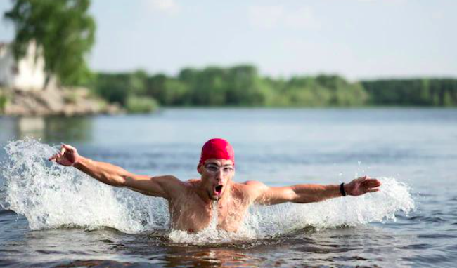
Introduction - Image Caption Generator
A system that can automatically generate textual description for images, based on understanding of visual content.
Involves understanding the visual context in CV and sentence generation in NLP.
fuse | ai

Slide 4
Problem Statement
“Given an input image, develop an algorithm or model that can generate a caption that accurately and contextually describes the contents of the image”.
“The models must be able to generalize well to unseen images and generate captions that are not only syntactically correct but also semantically meaningful.”
‹#›

Slide 5
Objectives
Utilize DL technique to automatically extract features from images and map them to relevant text.
Use computer vision to analyse the visual content of an image and extract relevant features, such as, object, colors, textures etc.
Use natural language processing to generate a coherent and meaningful sentence that describes important features and aspects of an image
fuse | ai

Slide 6
Problem Statement
“Given an input image, develop an algorithm or model that can generate a caption that accurately and contextually describes the contents of the image”.
“The models must be able to generalize well to unseen images and generate captions that are not only syntactically correct but also semantically meaningful.”
fuse | ai

Slide 7
Application
Aid to Blind : First converting the scene into text and then text to speech.
Self-driving cars : Can boost the system by captioning the scene around the car.
Google Image Search : Generating the caption of an image, image search can be performed based on the caption itself.
CCTV Cameras : Generating the relevant caption of the live activities and raising the alarms may help to reduce malicious activities around the world.
Healthcare : Generating description of medical images can help doctors to quickly identify potential issues.
Education : Automatically generate descriptions for visual materials used in lectures and presentations.
fuse | ai

Slide 8
Dataset Overview
Flickr Image Dataset
31.8k images with each having 5 captions.
8k images each paired with 5 different captions.
Training and Validation Set
4 caption from for each image train-set.
Remaining 1 caption in validation-set
fuse | ai

Slide 9
Tools and Technologies Used
Programming Language | Python 3
Framework | Pytorch, Tensorflow
Technologies and libraries | Keras, Numpy, Pandas, spacy
IDE | vscode
Version Control | Git
Build tool | Pip

Slide 10
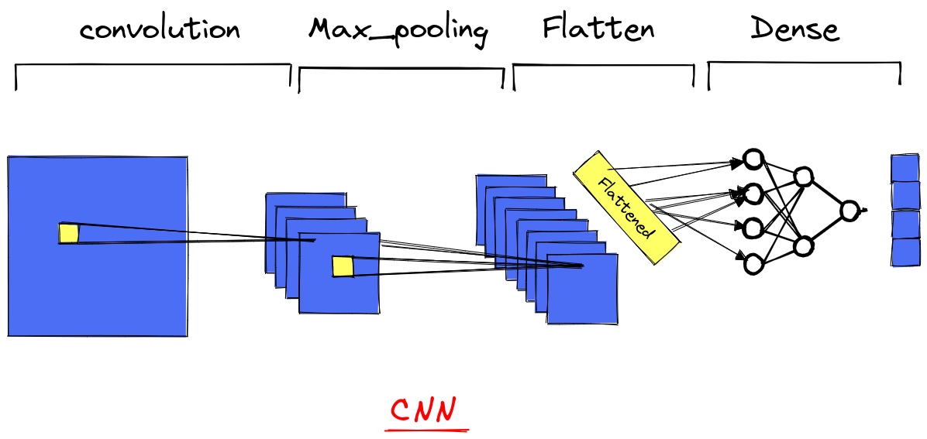
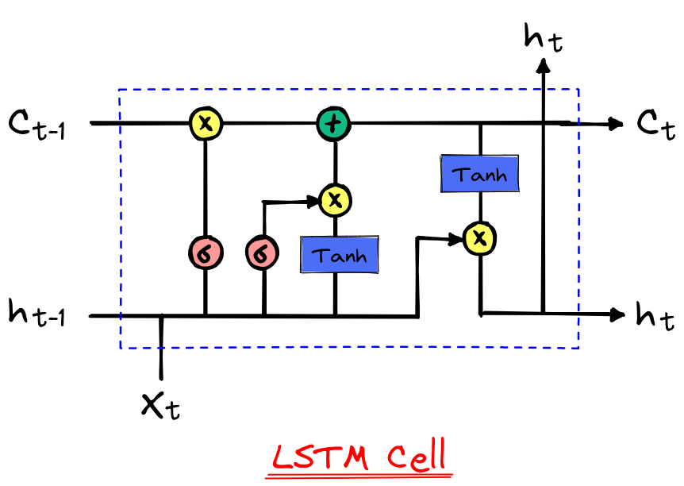
Model
fuse | ai
Encoder
Decoder

Slide 11
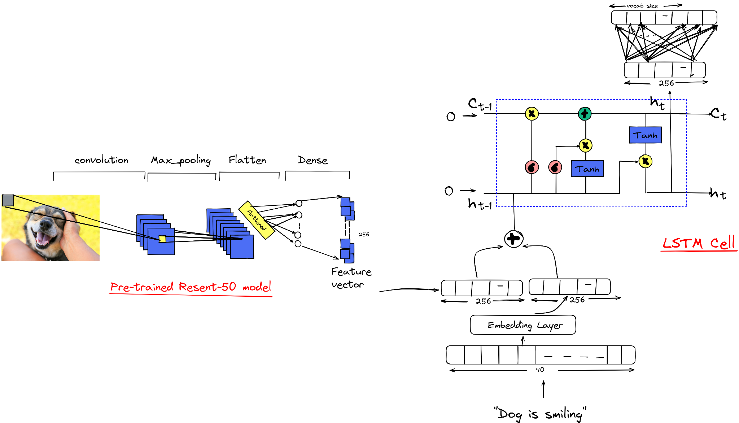
Model Architecture
fuse | ai

Slide 12
To evaluate the performance of our model on the test set, we employed two techniques.
BLEU (BiLingual Evaluation Understudy) score :
Compares machine translated text to professional human translation.
Calculated for each translated segment by comparing to a reference text
Higher score means closer to human quality.
2. Manual Evaluation :
Similar to Amazon Mechanical Turk.
Manual evaluation of generated captions.
Scores assigned on usefulness of description for image.
2 workers per image, bootstrapping for variance analysis.
Score assigned in the scale of 0 to 4.
Model Evaluation
fuse | ai

Slide 13
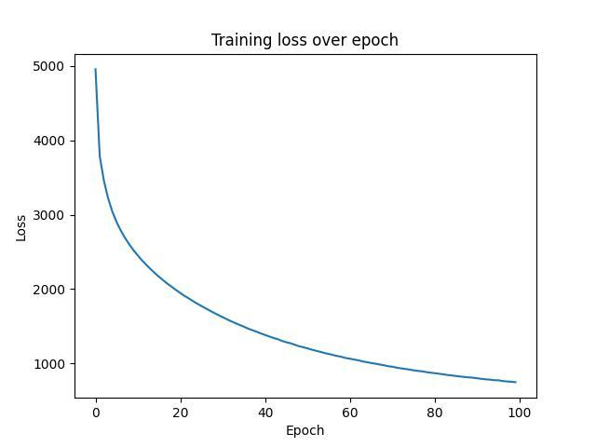
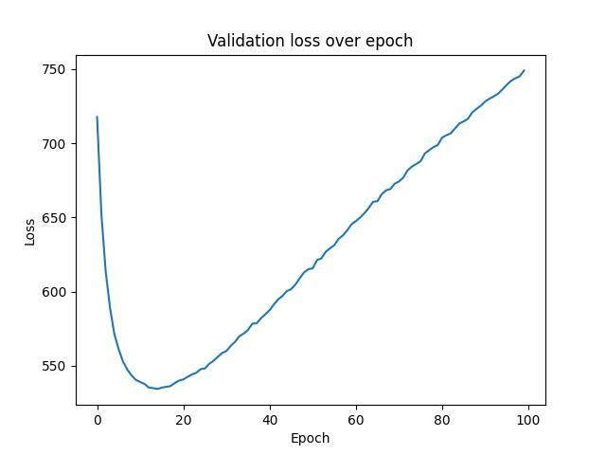
Result
fuse | ai

Slide 14
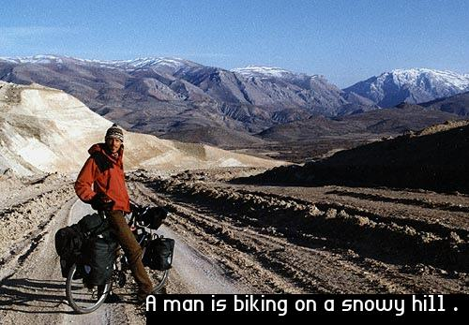
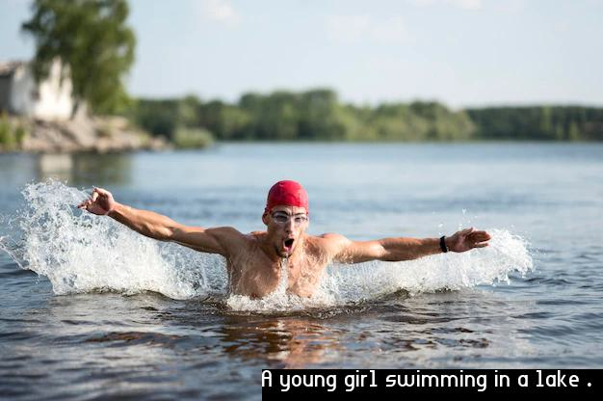
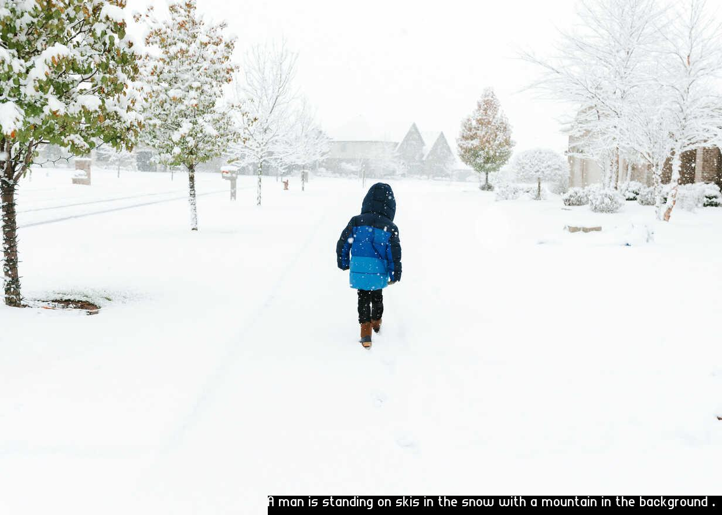
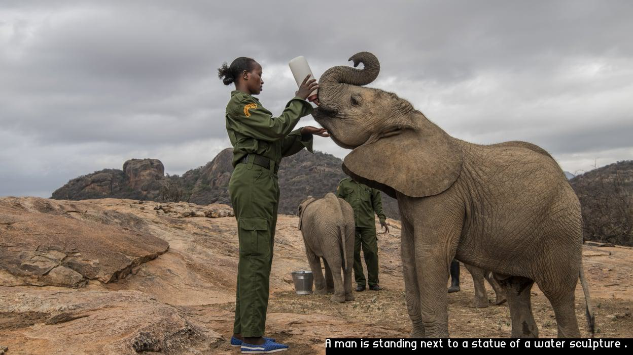
Result Sample
fuse | ai

Slide 15
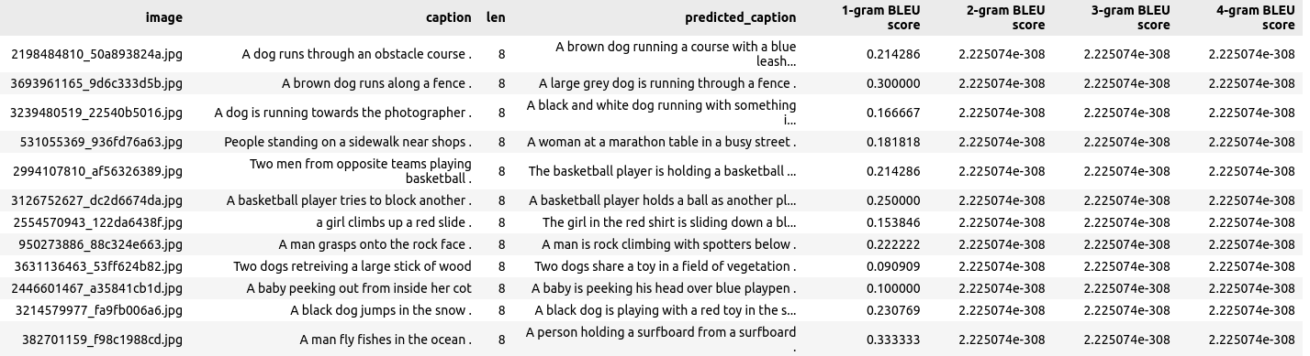
Score
fuse | ai

Slide 16
Thank You!
fuse | ai

